Slide 1
XAD Presentation
Team Voltron
Joseph Camacho-Terrazas, Gabriella Garcia, Xiana Lara, Phillip Powell

Slide 2
Original Tools: Knife and Cutting Board
Used for food preparation tasks
Cutting board provides a sanitary surface for food and prevents scratches to surface underneath
Knife slices food - different types of knives are better for slicing certain types of food.

Slide 3
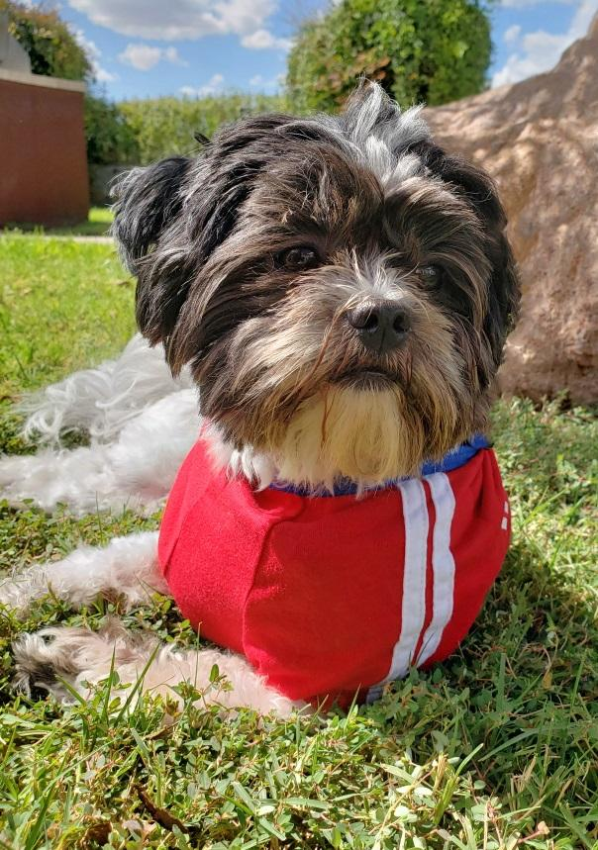
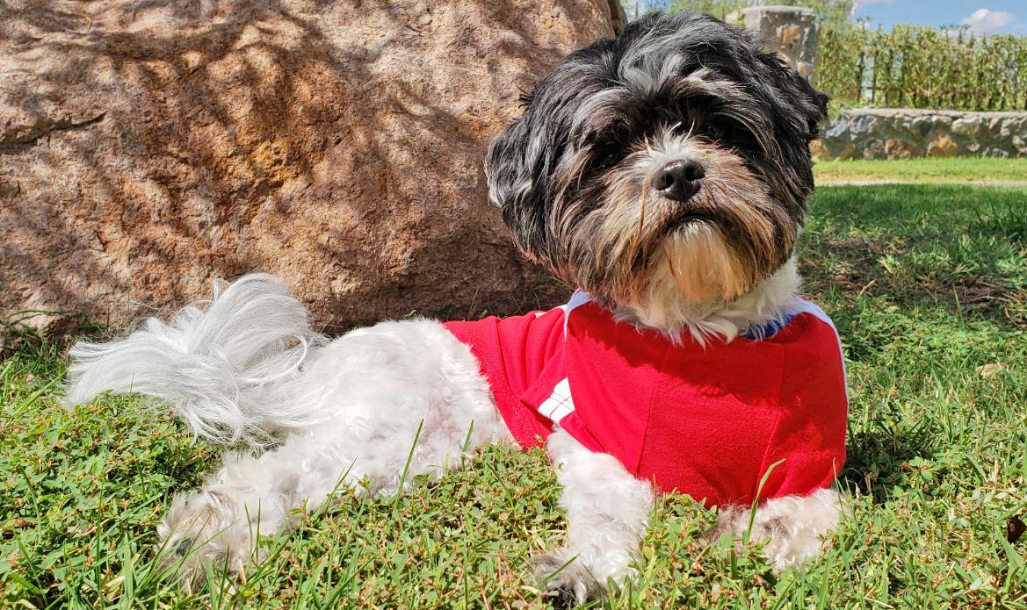
Animal in Consideration: Dog
4-legged mammal that is a domesticated descendant of wolves.
Several hundred dog breeds.
Mainly use their mouths to grasp and carry objects.

Slide 4
Description of New Tool
Mouth actuated knife and cutting board.
Consists of a handle connected to a spring tensioned pulley system.
Dog grasps handle and pulls it, then releases it.
System is double action, pulling brings the knife down like a guillotine, releasing the handle will advance the board forward by a small amount.
Multiple knife attachments are selectable by a pedal that is stepped on by the dog.
The amount of board movement is adjusted using another pedal to change slice thickness.

Slide 5
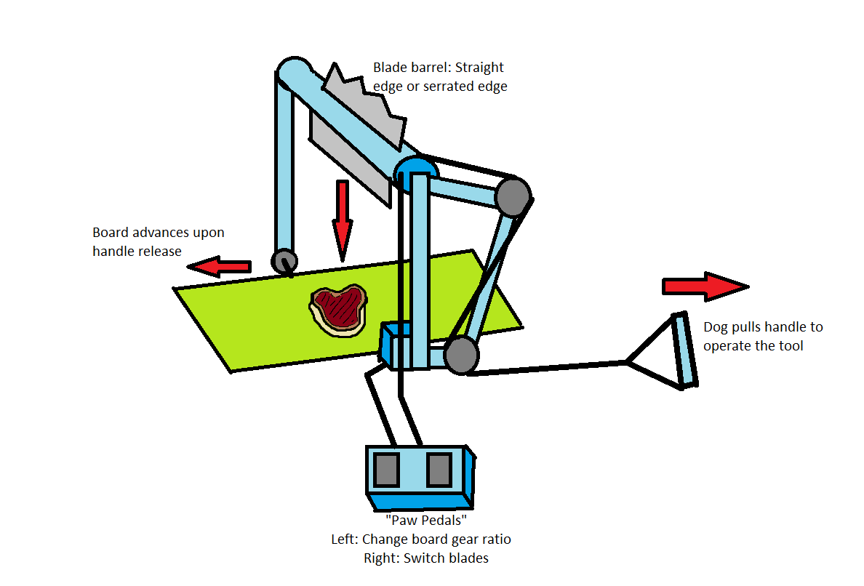

Slide 6
Human/Dog Tool Differences
Tools are not very different from their human counterparts.
Main difference is the motion used to operate the tool.
Tool is designed to replace the human hand and motion of a human arm.
Pulley system is in a dog’s natural range of motion, no need for any special movements.
Dogs instinctively bite and pull, dog will only have to learn to push the pedals.

Slide 7
Implications
Designing the tools makes us think about how users will interact with our interface.
It’s important to ensure that all features have accessibility in mind.
Some users may be able to operate UI one-handed, others may not.
Interaction points should be within easy reach for all hand types.
Double action of the pulley system also makes us think about how we can shorten processes so a single action will perform more tasks at once.

